Slide 1
TIMER in atmega32 – Part 2

Slide 2
Learning objective
How to generate square wave of different frequency and duty cycles?
Control the speed of DC motor
Control the position of servo motor
Simulate an analog signal

Slide 3
Introduction
In AVR Timer 1 Lecture, we learnt two features of a timer:
overflow interrupt
input capture
Overflow interrupt
triggered when timer reaches its limit
used to measure interval that is longer than one timer cycle
for finding the time elapse, creating a time delay.
Input capture
an interrupt triggered when there’s a change in pin ICP1
value of Timer 1 is automatically stored in register ICR1
for finding period/frequency/pulse width of a signal

Slide 4
output compare
In this lecture, we’ll study another important functionality of a timer
output compare
Output compare allows custom processing to be done
when timer reaches a preset target value
Output compare can be used to
generate square waves of various shapes
Pulse Width Modulation
perform actions such as ADC at specific time instants (See lecture on ADC)
Examples of custom processing
clearing timer
changing values of dedicated pins
triggering an interrupt

Slide 5
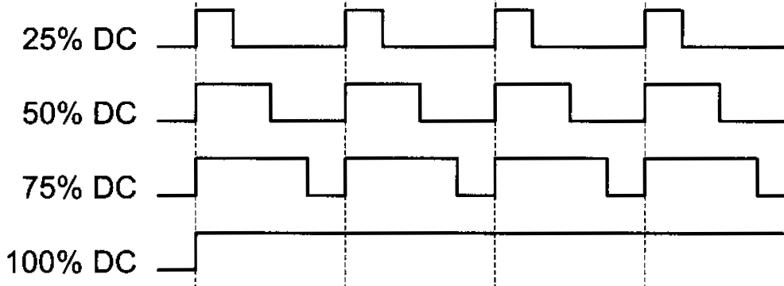
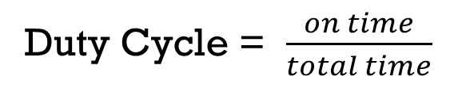
Pulse Width Modulation
Duty Cycle = $\frac{on time}{total time}$
The percentage of time in which the PWM signal remains HIGH (on time) is called as duty cycle.

Slide 6
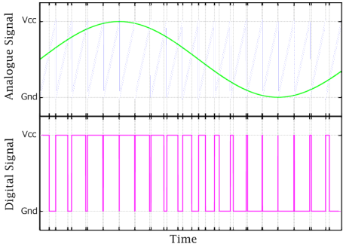
Simulating an analog signal
https://www.falstad.com/circuit/e-555pulsemod.html

Slide 7
Controlling power to a load
%

Slide 8
Output Compare - Common elements
Output compare registers (16 bit)
to store the target timer values
Output compare pins
the values of these dedicated pins can be automatically changed (set, reset, toggled) when there is an output compare match
Configuration registers
to configure the operations of timer
Output Compare Interrupt
code for extra processing when there is an output compare match can be put in ISR.

Slide 9
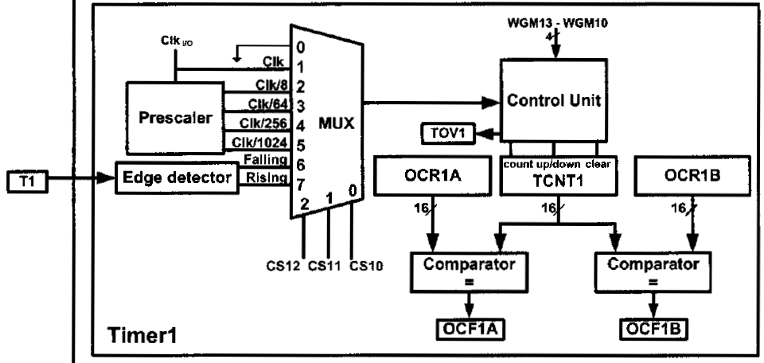
Timer 1

Slide 10
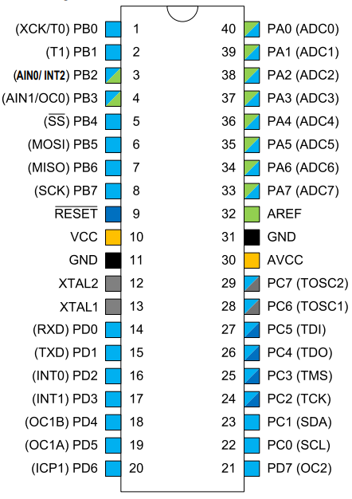
Output Compare Unit in Timer 1
Timer 1 has two output compare channels: A and B
Timer 1 is continuously compared to OCR1A or OCR1B or a fixed limit
When a match occurs, a flag OCF1x is set
where x = ‘A’ or ‘B’
When a match occurs, Timer 1 can
trigger an output compare interrupt
change output compare pins OC1x
PD4 and PD5 must be enabled for output

Slide 11
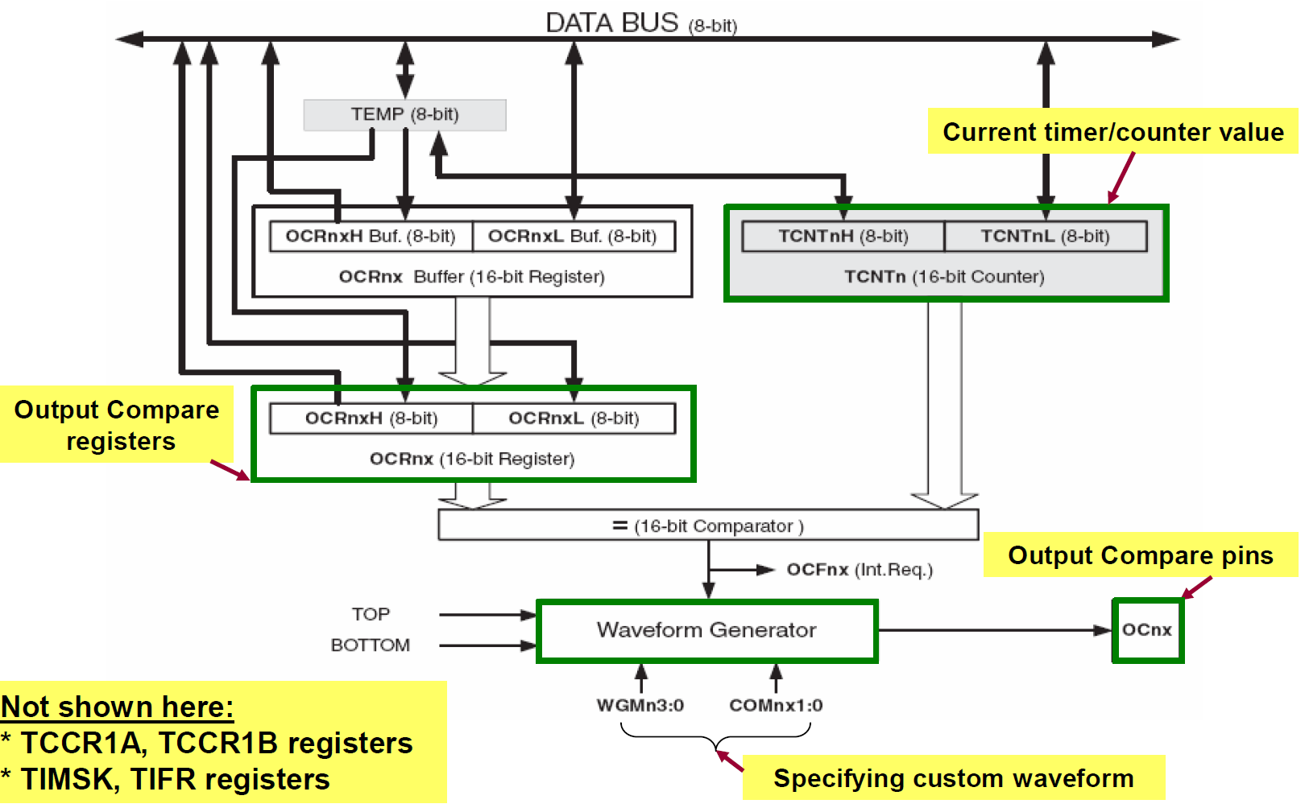
Output Compare Unit ─ Block diagram

Slide 12
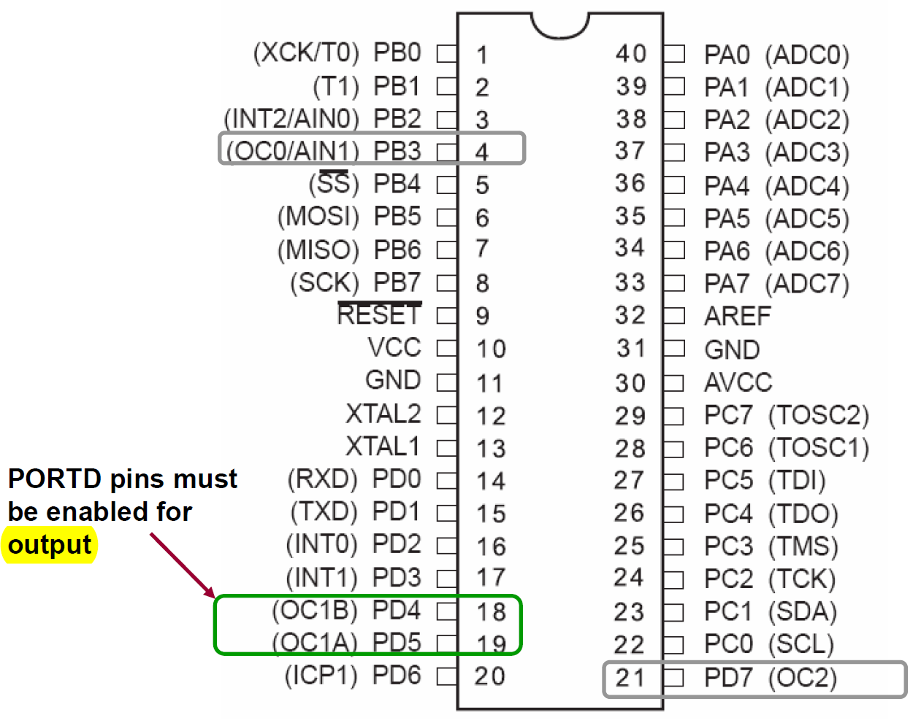
Relevant pins

Slide 13
Related Registers – Timer1
TIMER/COUNTER1
TCNT1
16 bit register that stores the current value of the counter
Timer/Counter 1 Control Registers
TCCR1A and TCCR1B
To configure the operations of Timer 1.
Interrupt registers
TIMSK to enable timer interrupts
TIFR to monitor status of timer interrupts

Slide 14
Related Registers – Timer1
4. Input Capture Register
- ICR1
- to store timer value when an event occurs on input capture pin
5. Output Compare Registers
OCR1A, OCR1B
To store the preset values for output compare

Slide 15
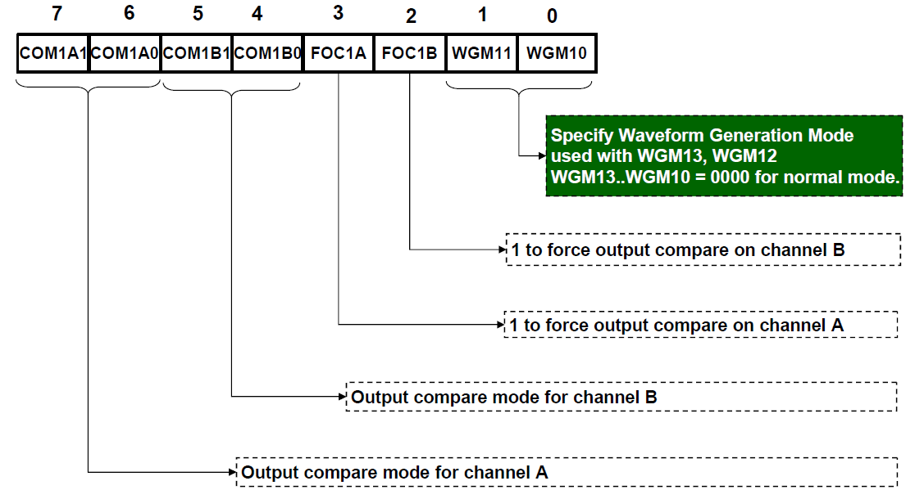
Timer/Counter 1 Control Register A (TCCR1A)

Slide 16
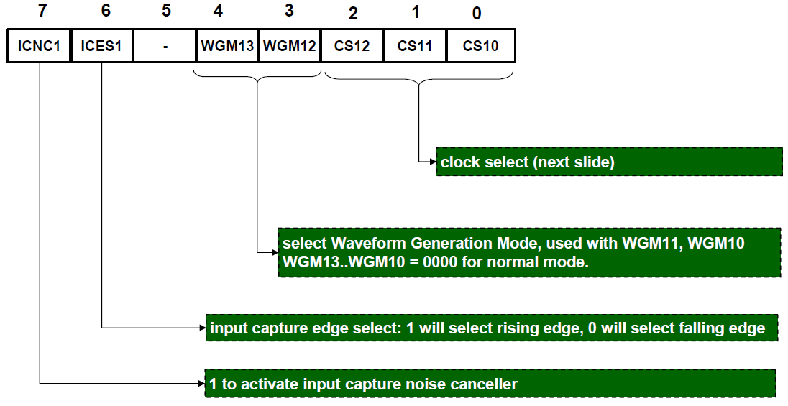
Timer/Counter 1 Control Register B (TCCR1B)

Slide 17
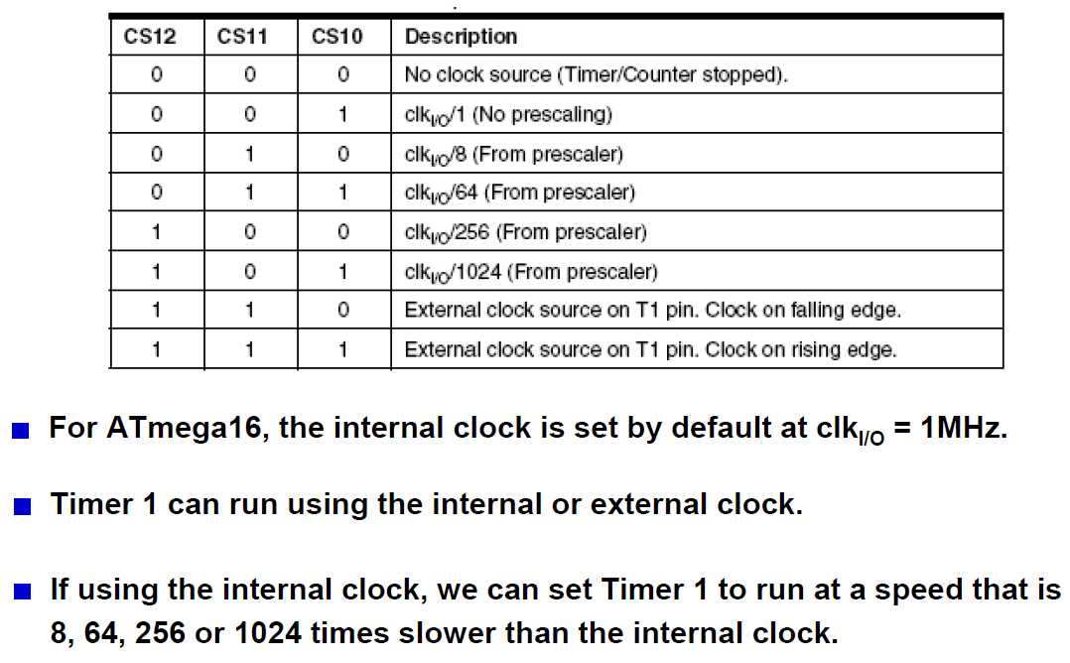
Clock select

Slide 18
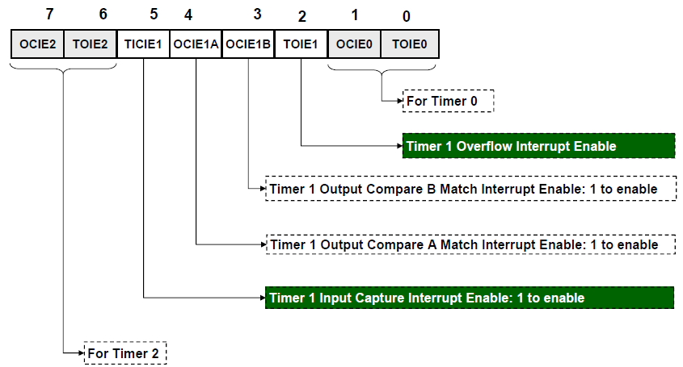
Timer/Counter Interrupt Mask Register (TIMSK)

Slide 19
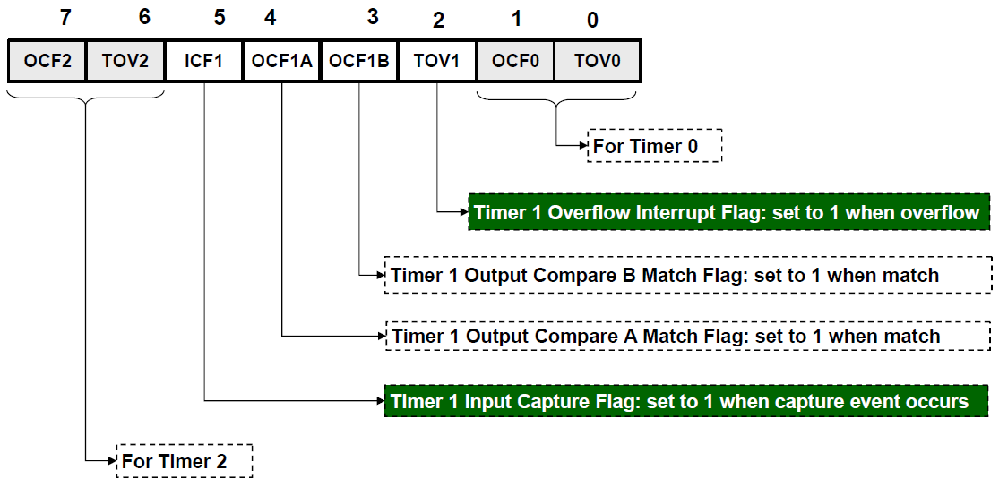
Timer/Counter Interrupt Flag Register (TIFR)

Slide 20
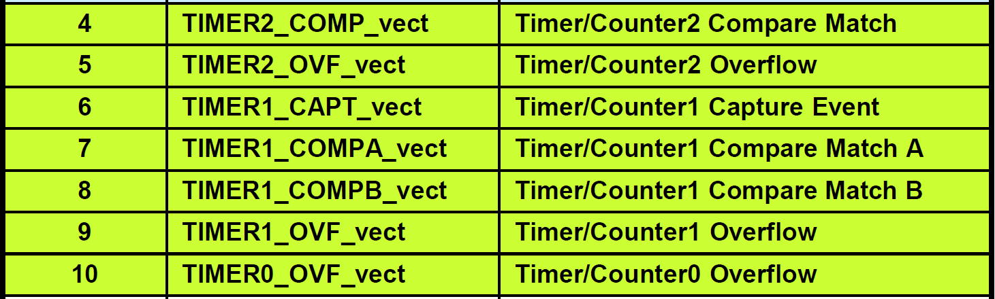
Timer related interrupts

Slide 21
Main aspects
What changes can be made to output compare pins OC1x?
What are the available operation modes of timer 1?
Steps to produce a custom waveform?

Slide 22
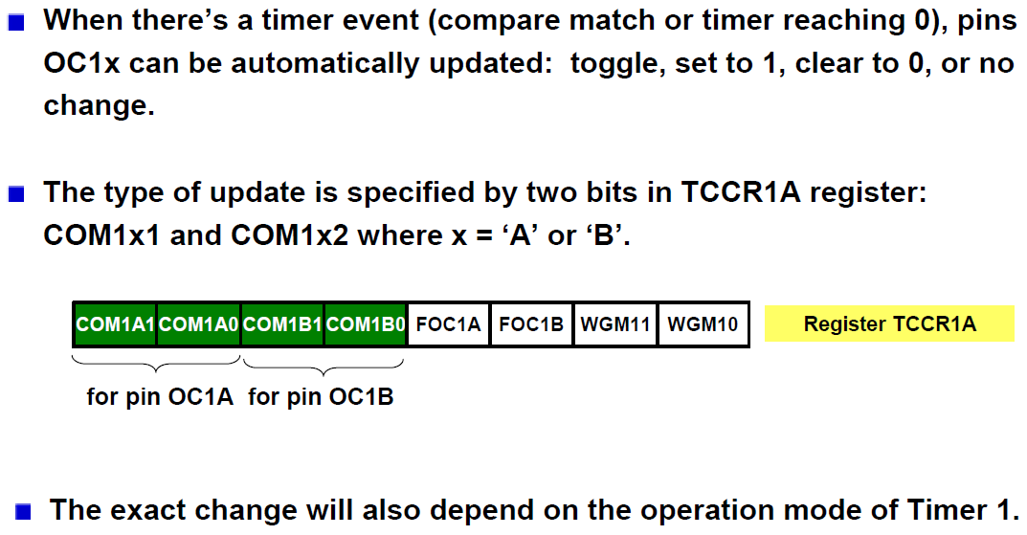
Changing output compare pins OC1x

Slide 23
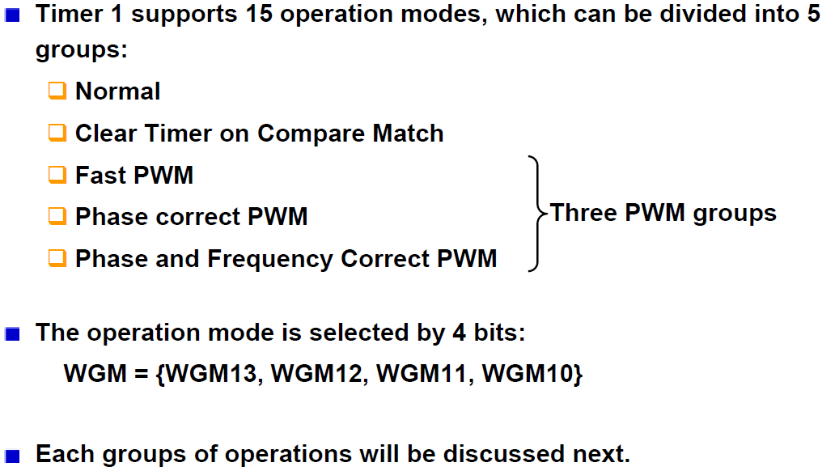
Operations modes of Timer 1
(CTC Mode)

Slide 24
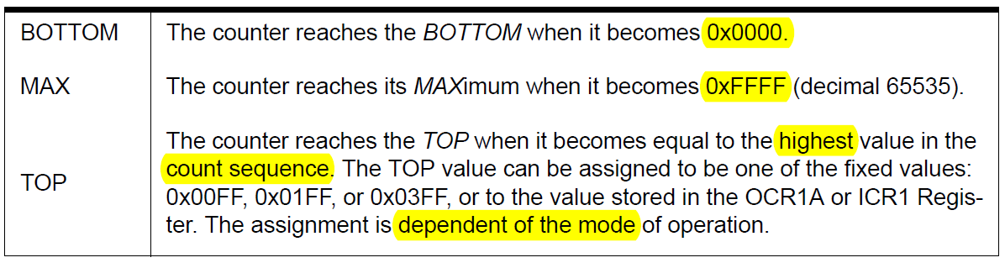
Some definitions

Slide 25
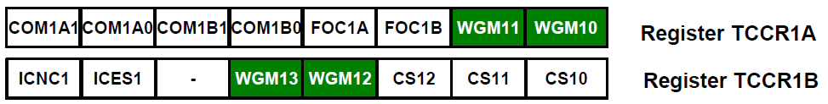
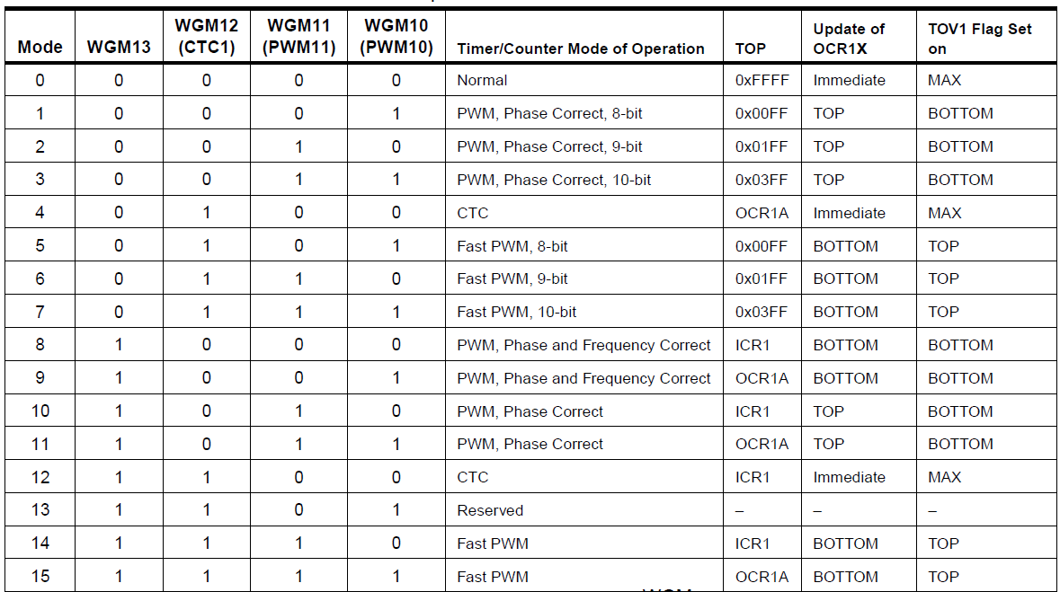
Selecting operation mode of Timer 1

Slide 26
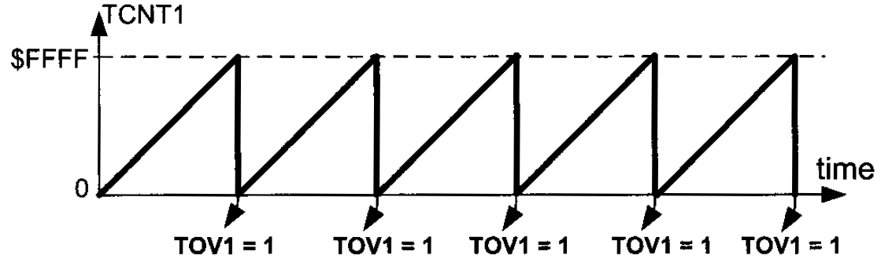
Normal mode (WGM13:10 = 0000)

Slide 27
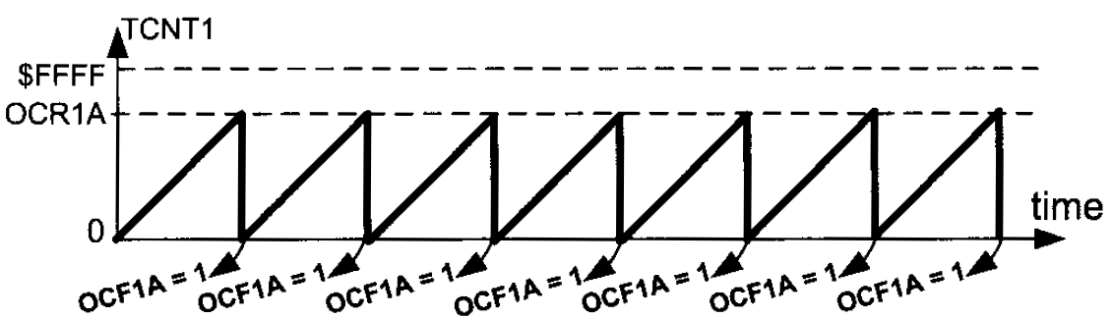
CTC mode (WGM13:10 = 0100)

Slide 28
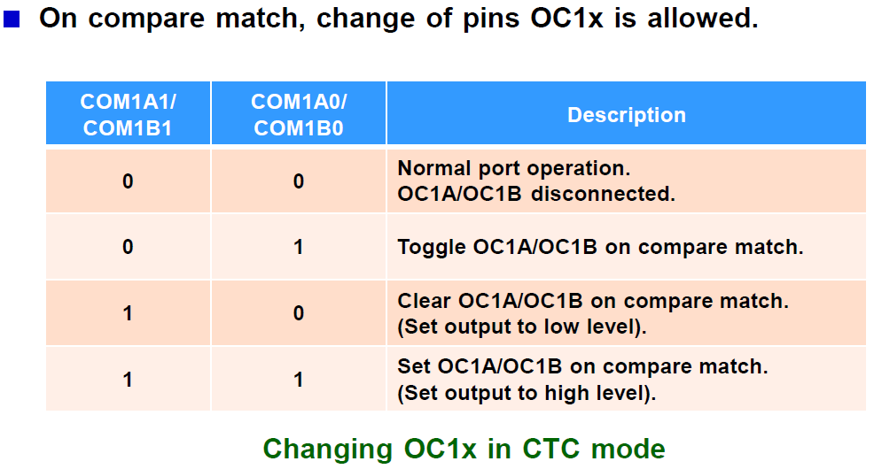
CTC modes

Slide 29
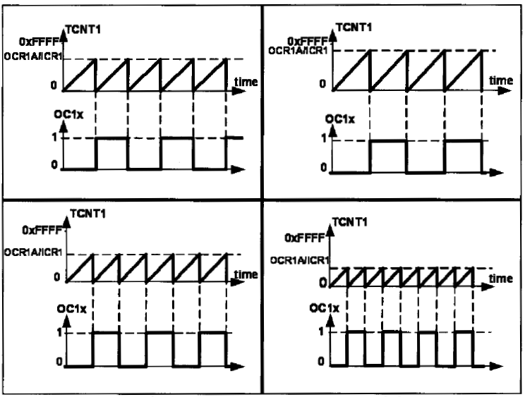
CTC modes
https://www.desmos.com/calculator/hryz8lwpvy

Slide 30
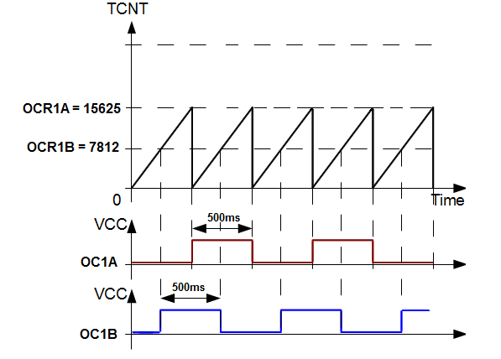
CTC modes
WGM13:10 = 0100
OCR1A = 15625
OCR1B = 7812
COM1A1:COM1A0 = 01
COM1B1:COM1B0 = 01
Counter is cleared on match with OCR1A.
Counter is continue on match with OCR1B

Slide 31
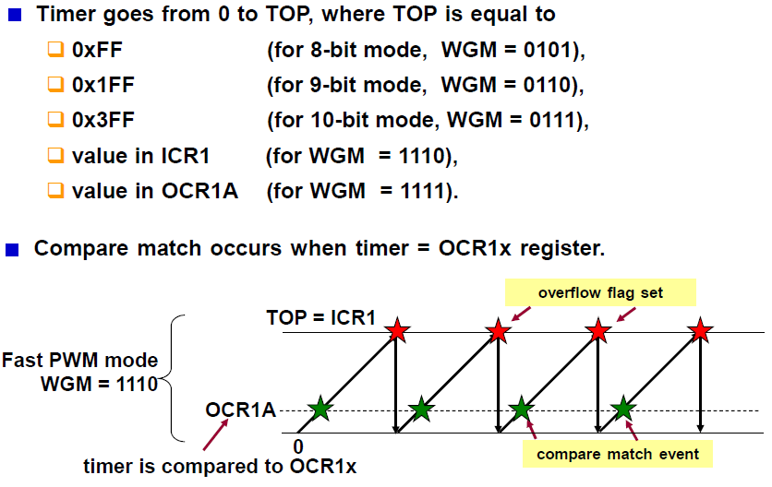
Fast PWM modes

Slide 33
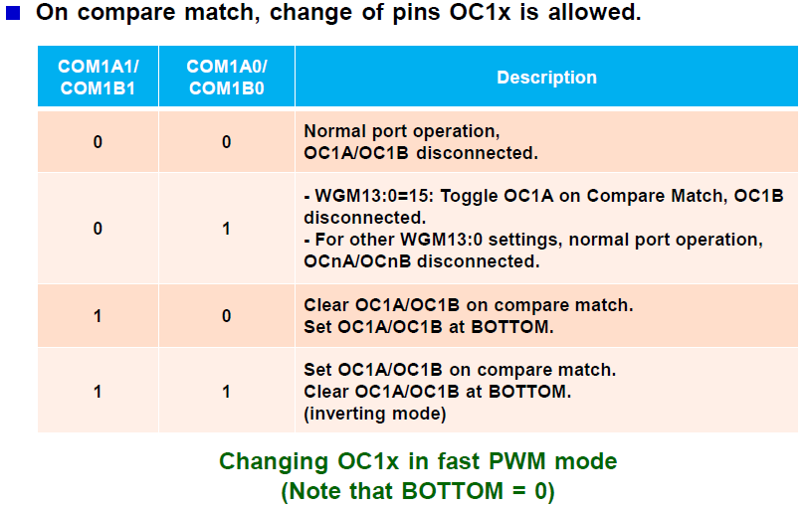
Fast PWM modes

Slide 34
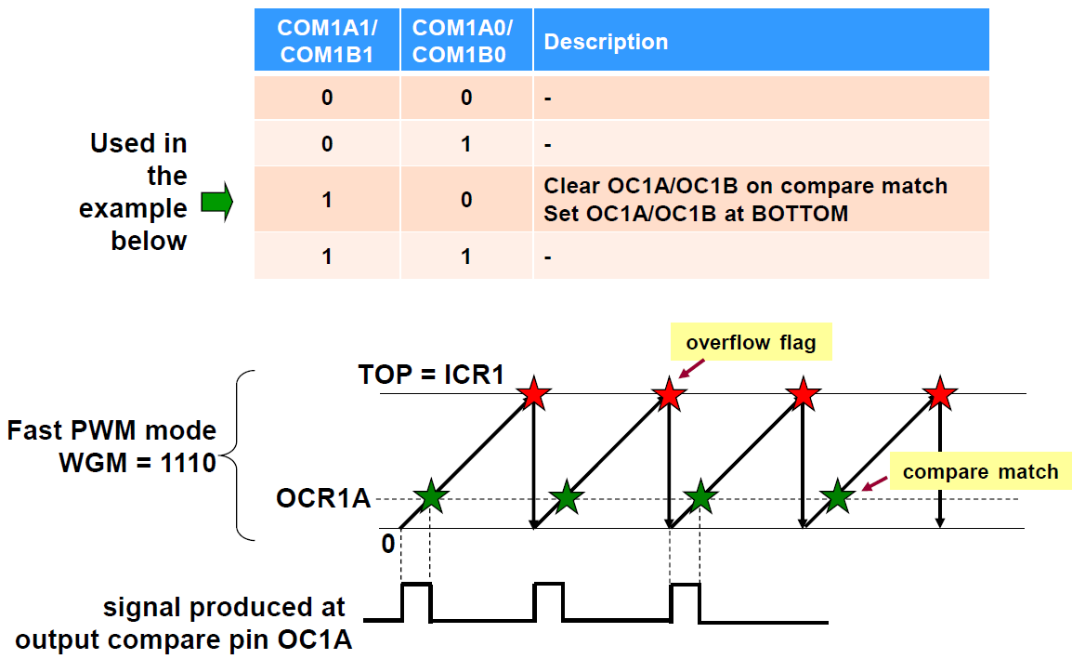
Fast PWM modes

Slide 35

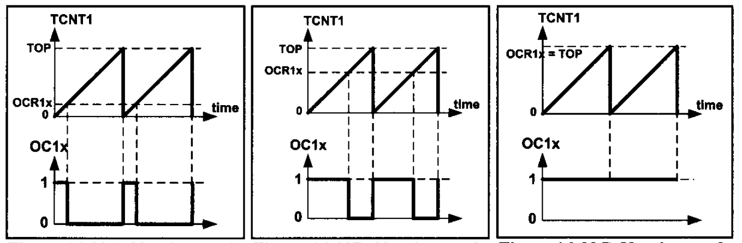
Fast PWM modes

Slide 36

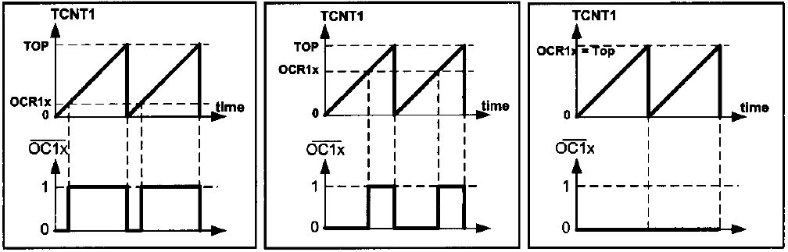
Fast PWM modes

Slide 37
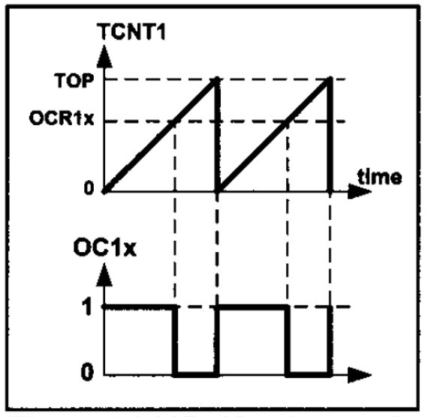

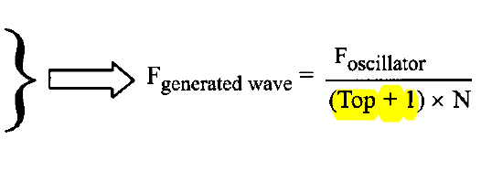

Fast PWM modes
What is the frequency?

Slide 38
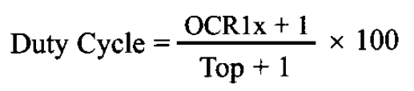
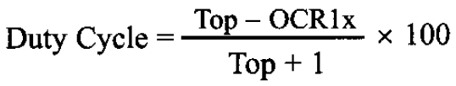
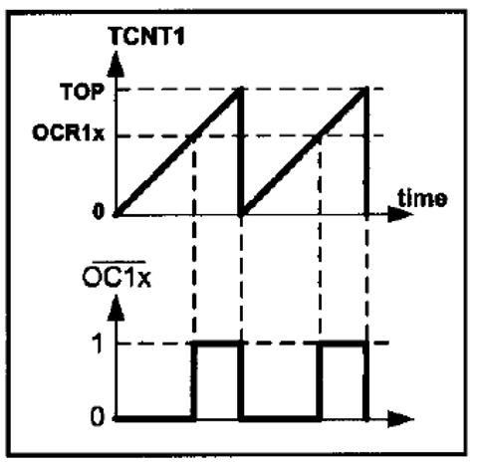
Fast PWM modes
What is the duty cycle?

Slide 39
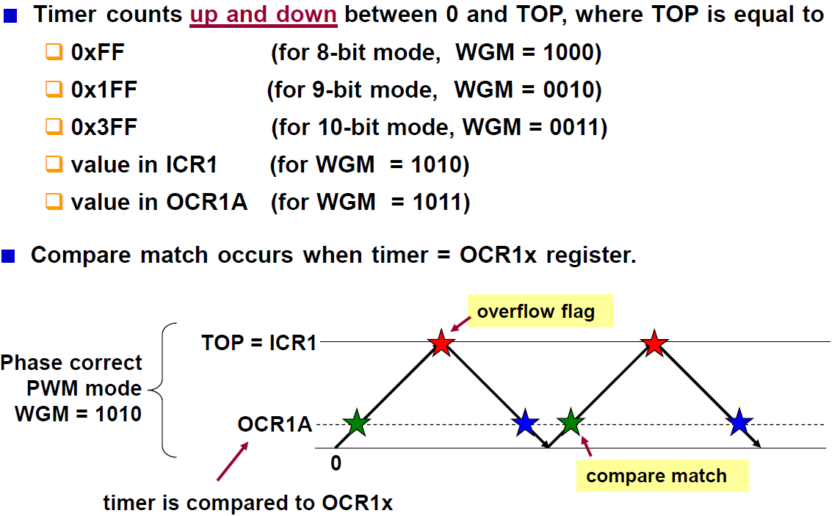
Phase Correct PWM modes

Slide 40
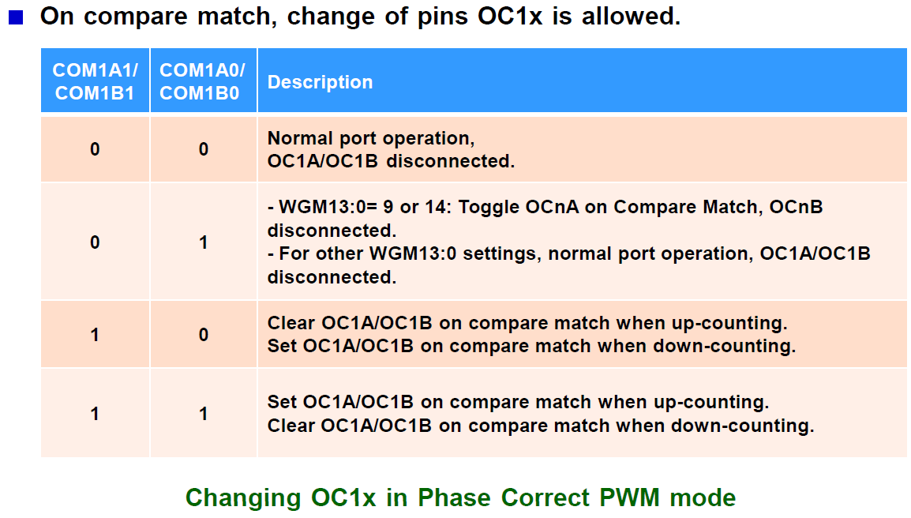
Phase Correct PWM modes

Slide 41
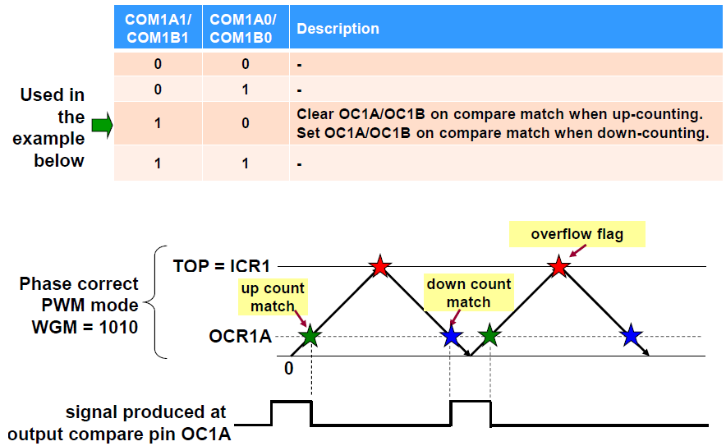
Phase Correct PWM modes

Slide 42
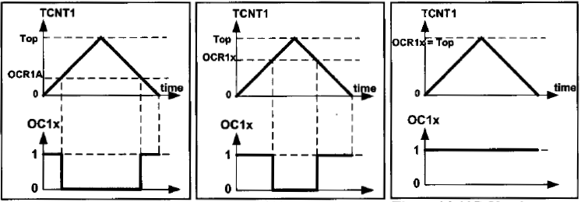
Phase Correct PWM modes

Slide 43
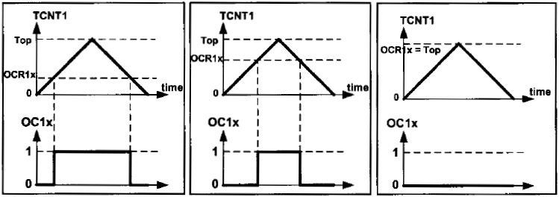
Phase Correct PWM modes

Slide 44
Phase Correct PWM modes
Self Study
Frequency
Duty cycle
AVR Microcontroller & Embedded Systems: Chapter 16

Slide 47
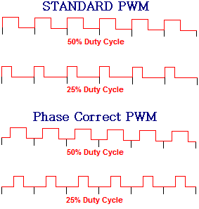
Phase Correct vs Fast PWM
The maximum possible frequency of the Fast PWM output is 2X that of the phase correct PWM
In Fast PWM, the phase of the wave is different for different duty cycles
while it remains unchanged in the Phase correct PWM

Slide 48
Phase Correct vs Fast PWM
Phase Correct PWM
Preferred for motor control
Due to the symmetric feature
Fast PWM
Where the phase change does not matter
Need to generate waves with high frequencies.

Slide 49
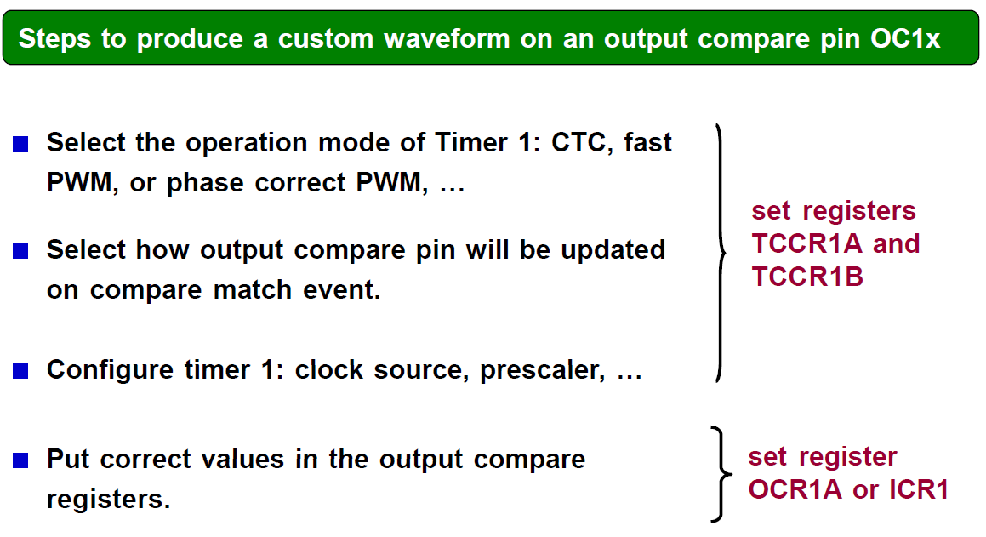
Producing a custom waveform

Slide 50
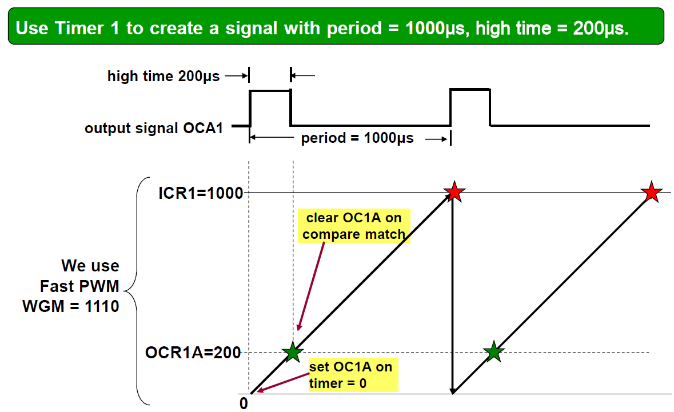
Producing a custom waveform
999
199

Slide 51
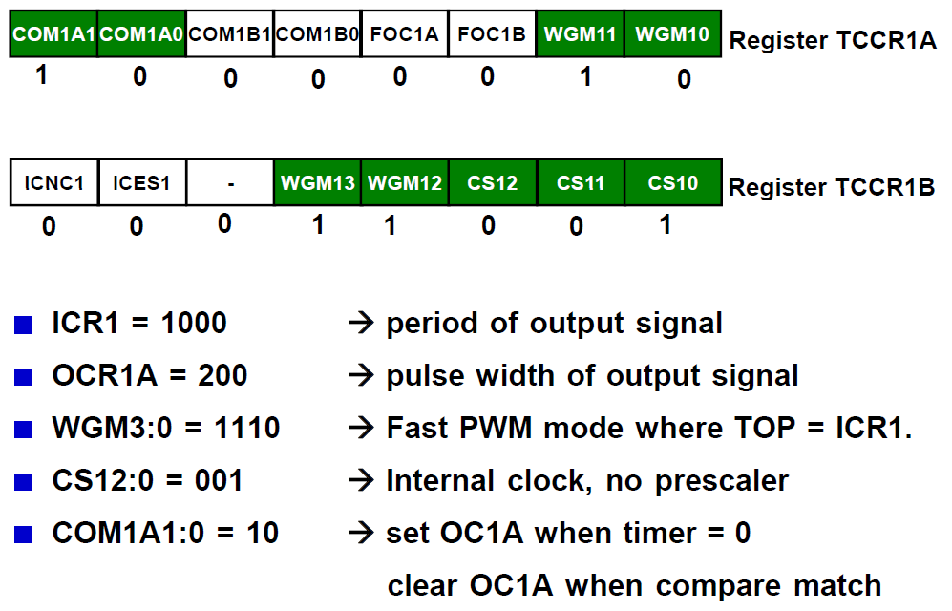
Producing a custom waveform
999
199

Slide 52
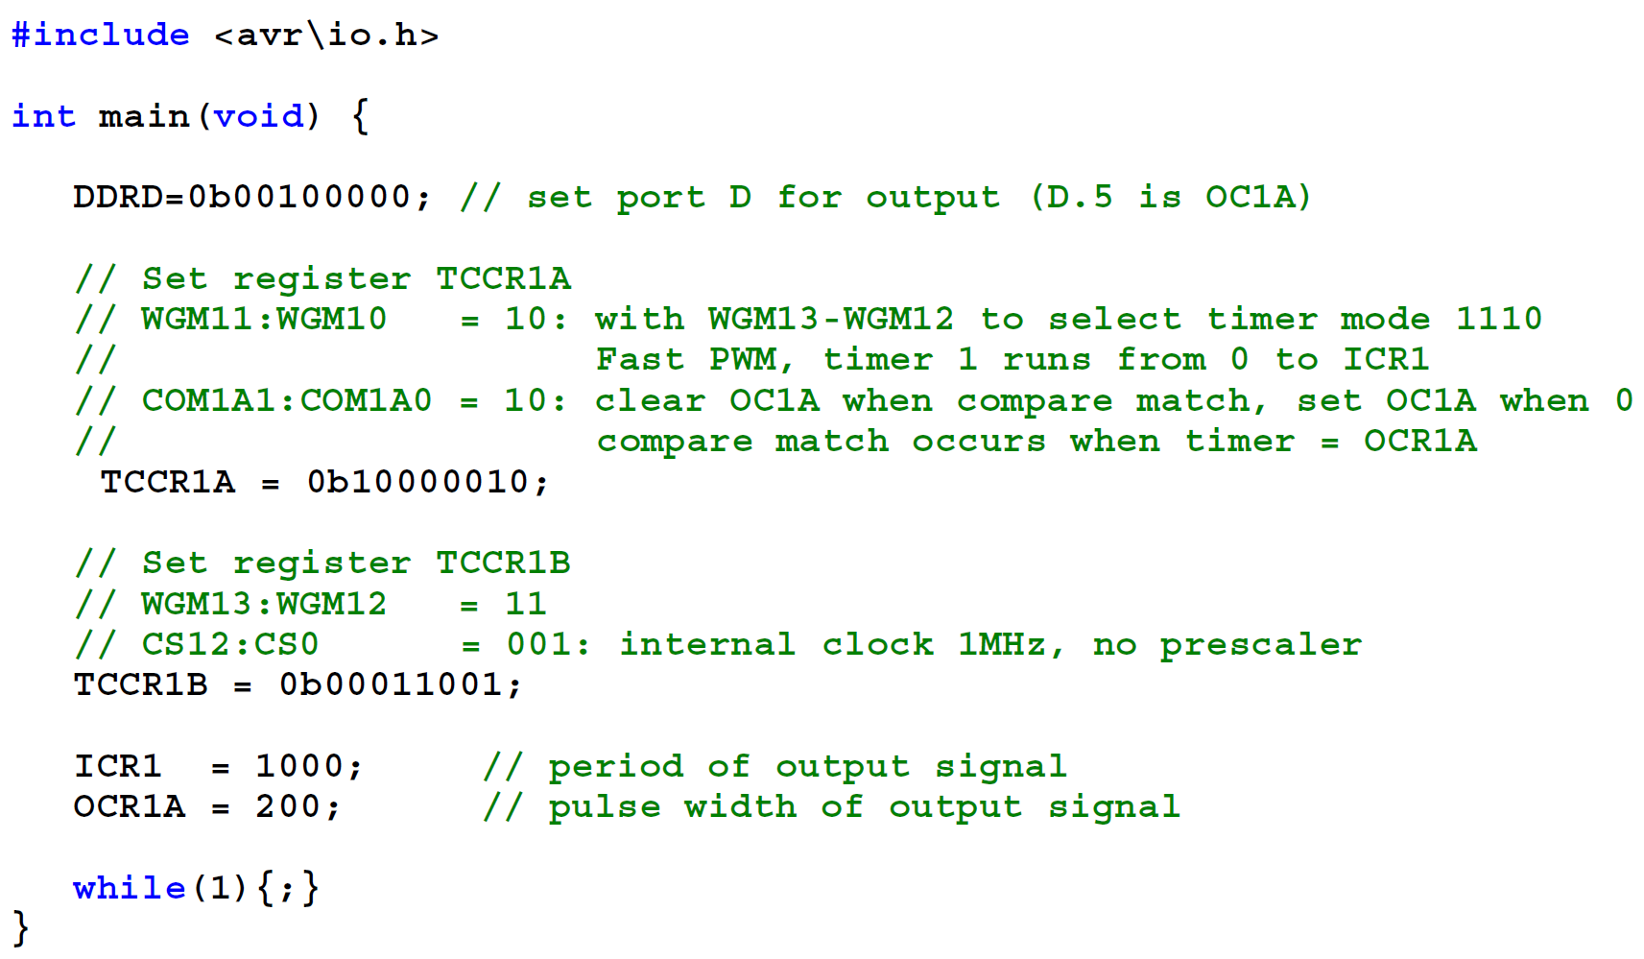
999
199

Slide 53
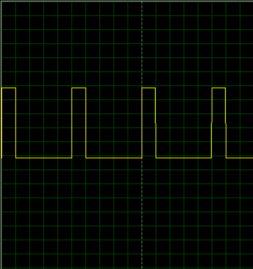
Producing a custom waveform
Y-axis
1 step = 1 v
X-axis
1 Step = 200 us

Slide 54
Practice problem
Use Timer 1’s output compare interrupt to toggle pin B.1 every 1000μs
Assume System clock frequency = 8 MHz. Write a program that generates waves with duty cycles of 30% and 60% on the OCIA and OCIB pins, respectively. The frequency of the generated waves should be 125 Hz

Slide 55
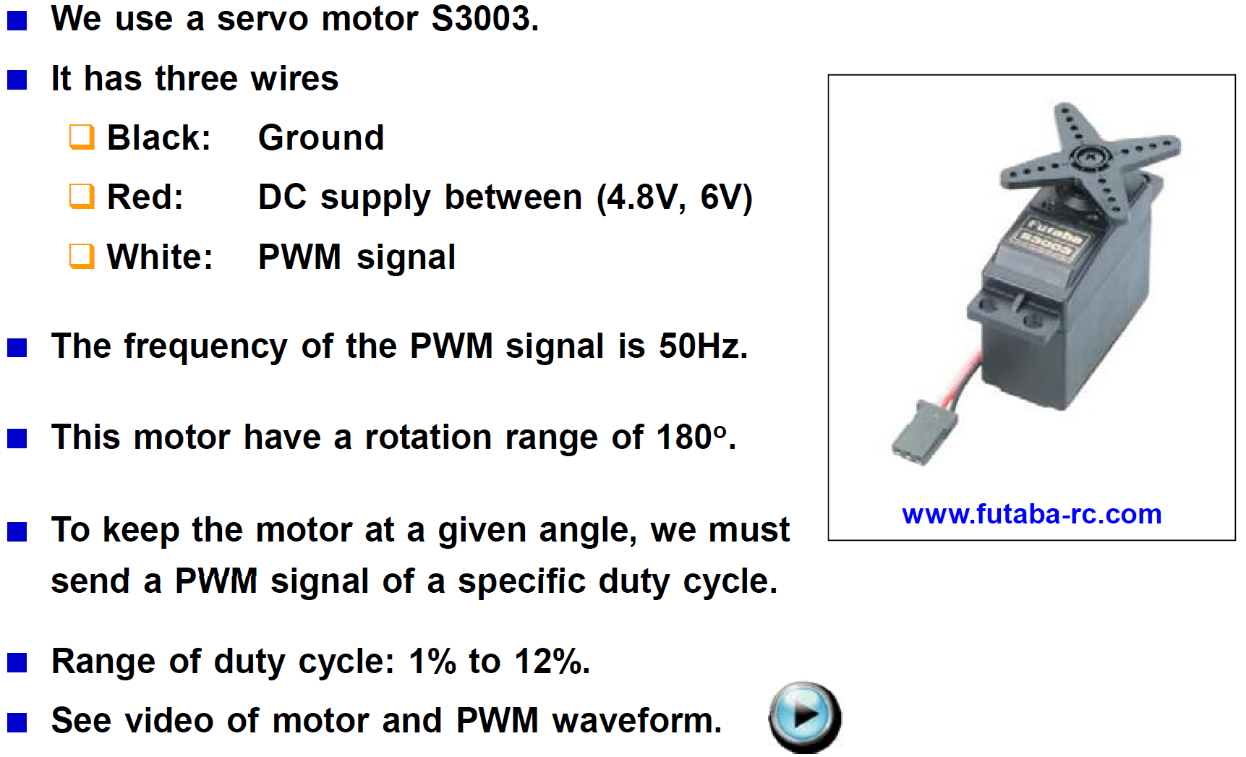
Controlling a servo motor

Slide 56
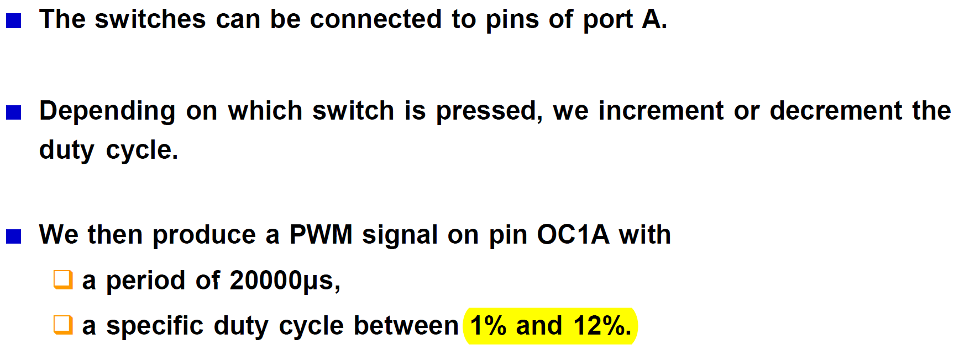
Controlling a servo motor
Write C program that lets the user press two switches to rotate the motor left and right.

Slide 57
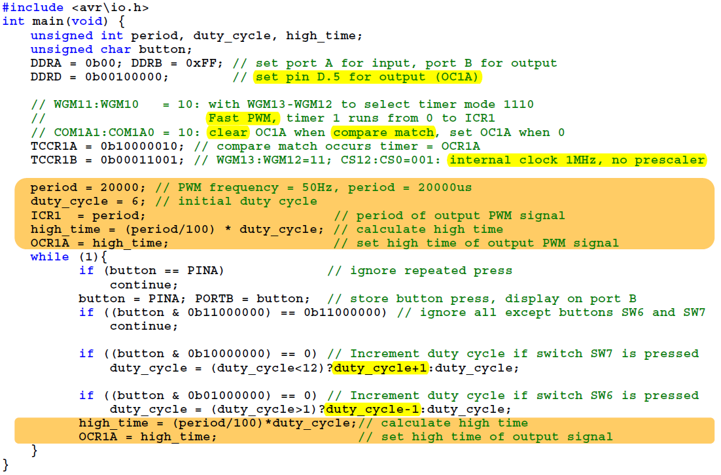
period – 1;
high_time – 1;
high_time – 1;

